Slide 1
Panther Parents’ Association
Claflin University
Division of Student Development and Services
Office of Career Development
Program for Service Learning and Community Service
1

Slide 2
Welcome
Your student’s college experience is an exciting time for the whole family, and your role in your student’s life will be integral in the coming years. Research shows that family involvement is critical to student success. We hope that you know parents and families are valued as partners in education here at Claflin. Students benefit when their family supports and participates in their university experience, while also encouraging the student to take responsibility for that experience.
2

Slide 3
Mission and Purpose
The purpose of the Association is to support and promote the interests of parents, students, and alumni of Claflin University.
The mission of the Association is to:
1. Promote student success and academic excellence;
2. Engage parents in the university’s mission and goals;
3. Support recruitment effort;
4. Involvement in fundraising efforts for student scholarship benefits, Parents’ Association,
and Claflin University Capital Campaign;
5. Assist parents to play a supportive role in student education; and
6. Connect with university administrators, faculty, staff, students, and parents.
3

Slide 4
Positions and Vacancies
Holding office is a vital factor in the success of the association. Position will be held for one academic year and members will vote for those running in the next year’s election.
The following positions are vacant for the upcoming year:
President
Vice President
Recording Secretary
Events Coordinator
Fundraising Coordinator
Those interested in holding office should contact Mr. Jabian M. Cooper, Program Coordinator for Service Learning and Community Service, at jcooper@claflin.edu or 803.535.5466.
4

Slide 5
Registration Forms
In order to receive important information regarding the university and the Parents’ Association, parents will need to complete a registration form (next slide) and submit by email or complete the digital registration by clicking the link below.
https://forms.gle/vdZis4DnzQPoKq3g9
5

Slide 6
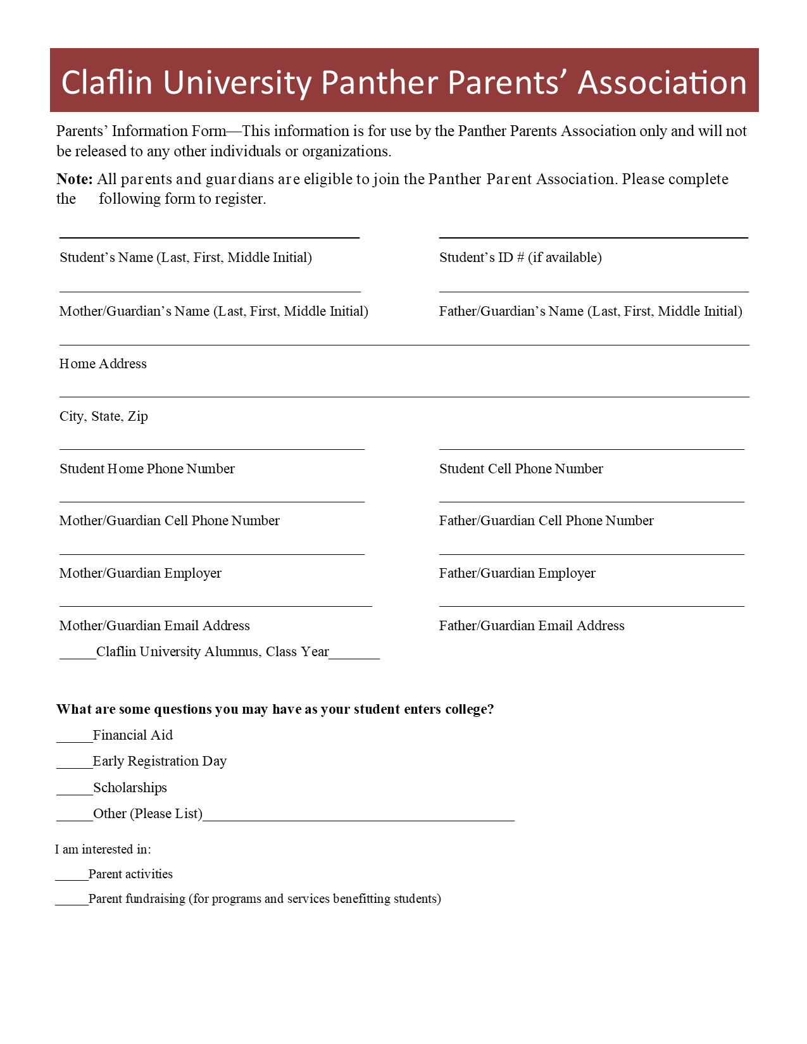
6

Slide 7
Office of Career Development Staff
Located in Corson Hall
7

