Slide 1
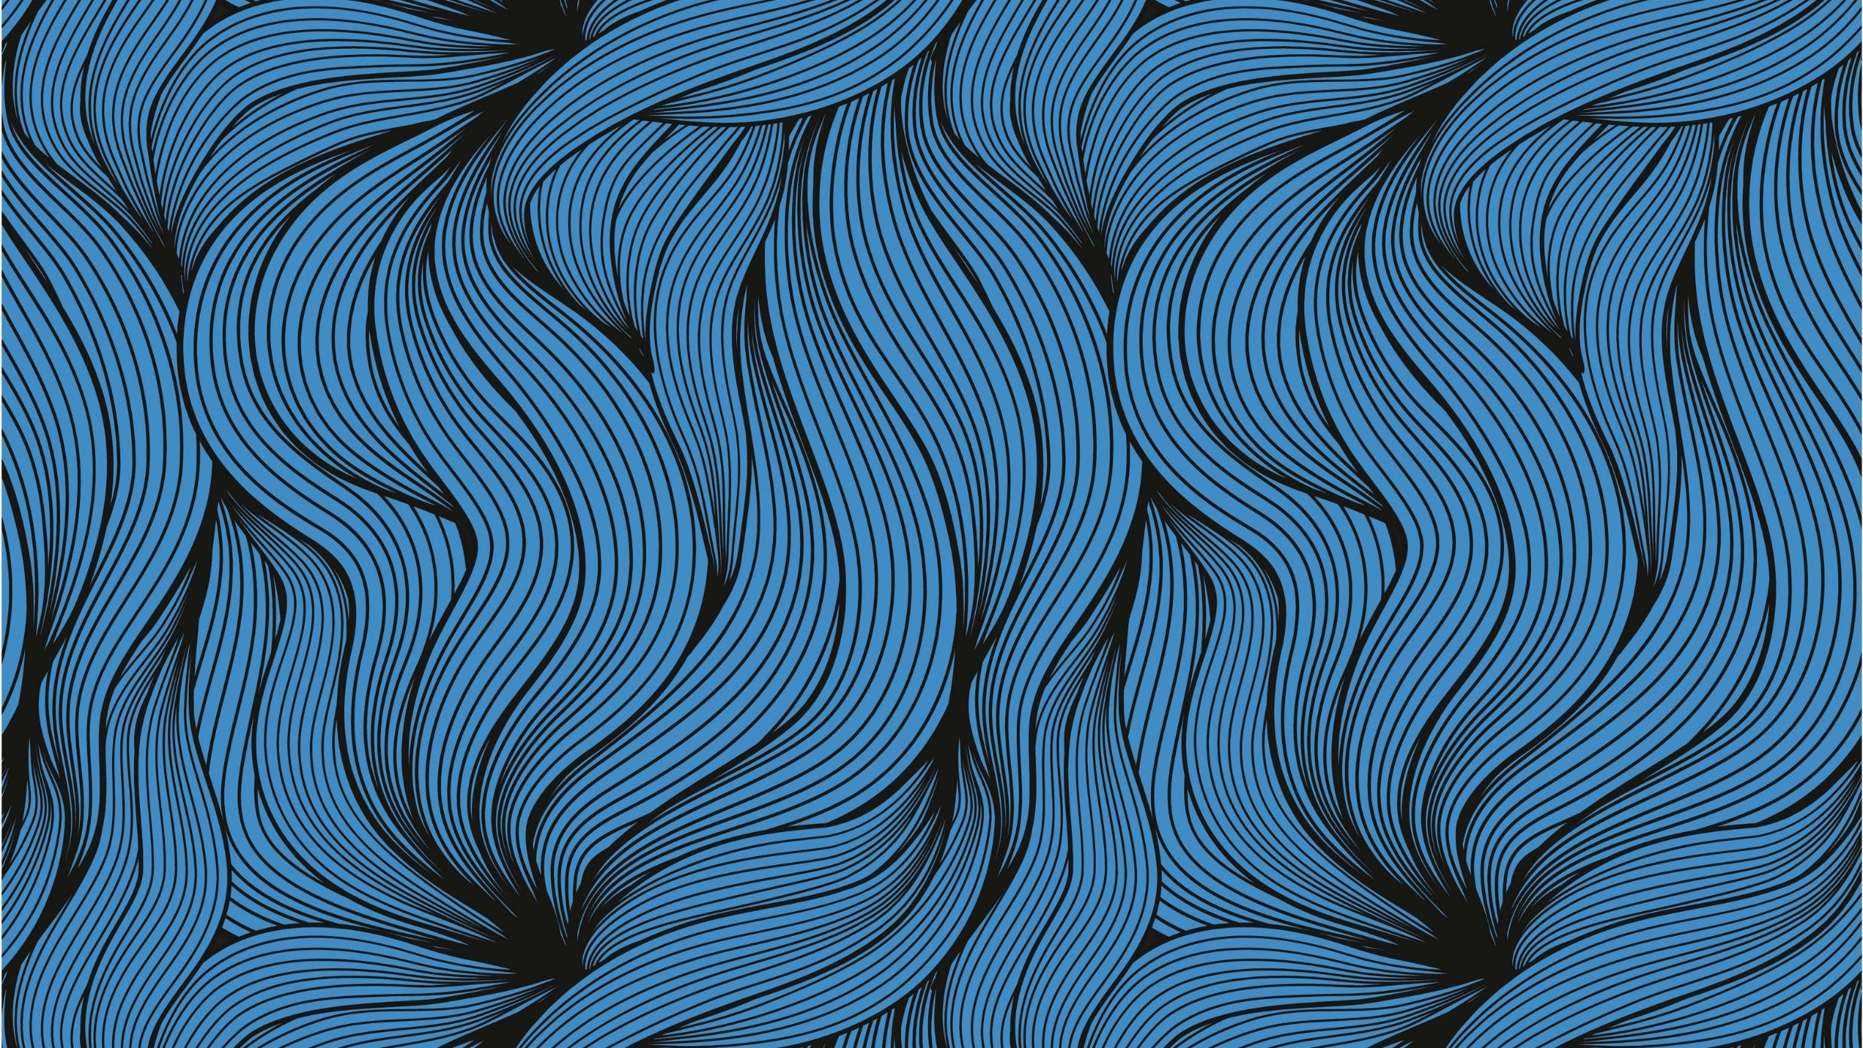
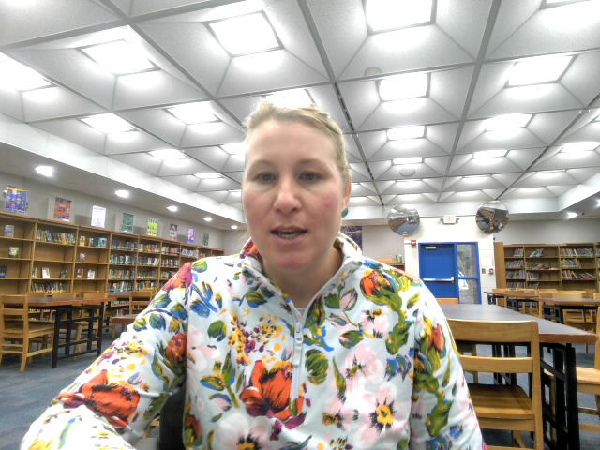
1984 and Library of Congress

Slide 2
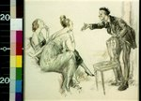
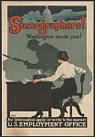
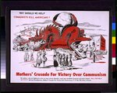
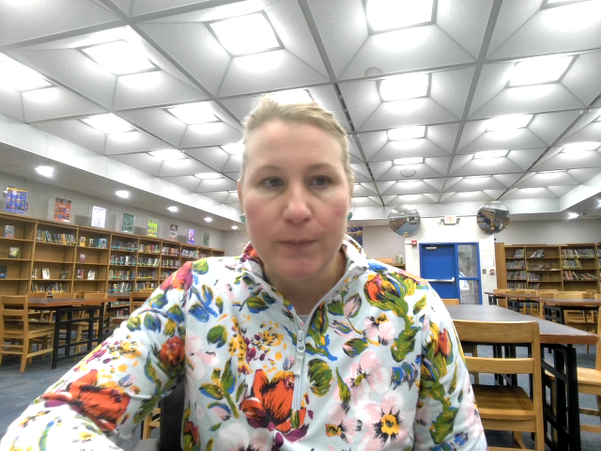
Students will create a video essay using images from the Library of Congress to example how women or the female perspective is portrayed.

Slide 3
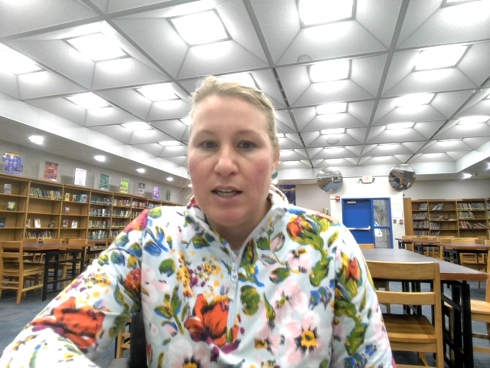
References
Mothers' Crusade For Victory Over Communism, S. Mothers' Crusade for Victory over Communism Why should we help communists kill Americans?. United States, None. [Between 1965 and 1973] [Photograph] Retrieved from the Library of Congress, https://www.loc.gov/item/2015648093/.
Still, R. H. (ca. 1918) Stenographers! Washington needs you! / Still. United States, ca. 1918. [New York: Prudential Litho. Co] [Photograph] Retrieved from the Library of Congress, https://www.loc.gov/item/2002722567/.
Wright, G. H. (1919) Women of the highest position feel deeply the beauty of the Bolshevik doctrine. , 1919. [?] [Photograph] Retrieved from the Library of Congress, https://www.loc.gov/item/2010718552/.

