Slide 1
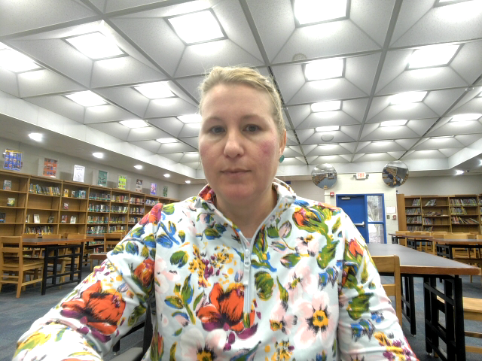
Gatsby and Library of Congress: National Juke Box

Slide 2

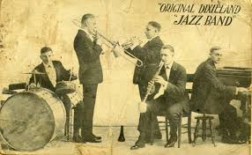
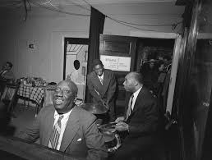
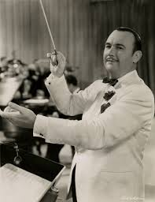
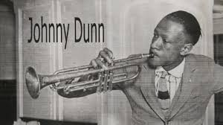

Livery Stable Blues
Pictured below: The Dixieland Jazz band.
Bleeding Hearted Blues Pictured below: James P. Johnson.
Sweet Lovin’ Momma Please Come Back To Me
Pictured below: Johnny Dunn
Hot Lips
Pictured to the left: Paul Whiteman.

Slide 3
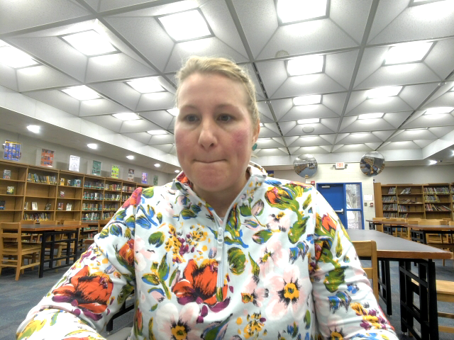
Student Assignment
Students would listen to the Jazz samples from the Library of Congress (LOC) comparing and contrasting the four samples. After which, students would create a Party Playlist using the LOC National Jukebox collection that consists of 10-15 songs from the appropriate time period that would be played at one of Gatsby’s parties.

Slide 4
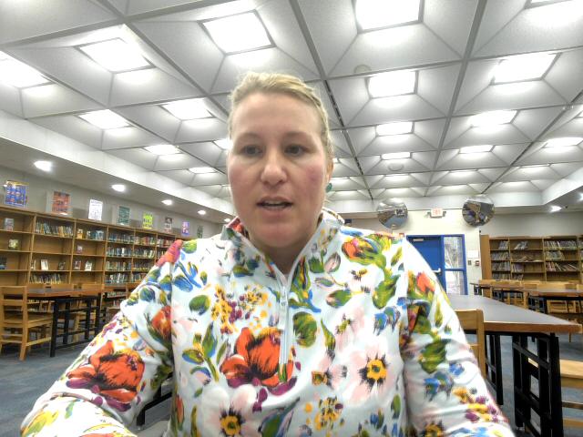
References
Johnny Dunn’S Original Jazz Hounds & Dunn, J. (1923) Sweet Lovin' Mama Please Come Back to Me. [Audio] Retrieved from the Library of Congress, https://www.loc.gov/item/jukebox-670670/.
Johnson, J. P. & Austin, L. (1923) Bleeding Hearted Blues. [Audio] Retrieved from the Library of Congress, https://www.loc.gov/item/jukebox-67476/.
Original Dixieland Jazz Band, Larocca, N., Edwards, E., Shields, L., Ragas, H., Sbarbaro, T. & Larocca, N. (1917) Livery Stable Blues. [Audio] Retrieved from the Library of Congress, https://www.loc.gov/item/jukebox-186254/.
Whiteman, P., Paul Whiteman Orchestra, Doerr, C. & Lange, H. (1922) Hot lips He's got hot lips when he plays jazz. [Audio] Retrieved from the Library of Congress, https://www.loc.gov/item/jukebox-63013/.

