Slide 1
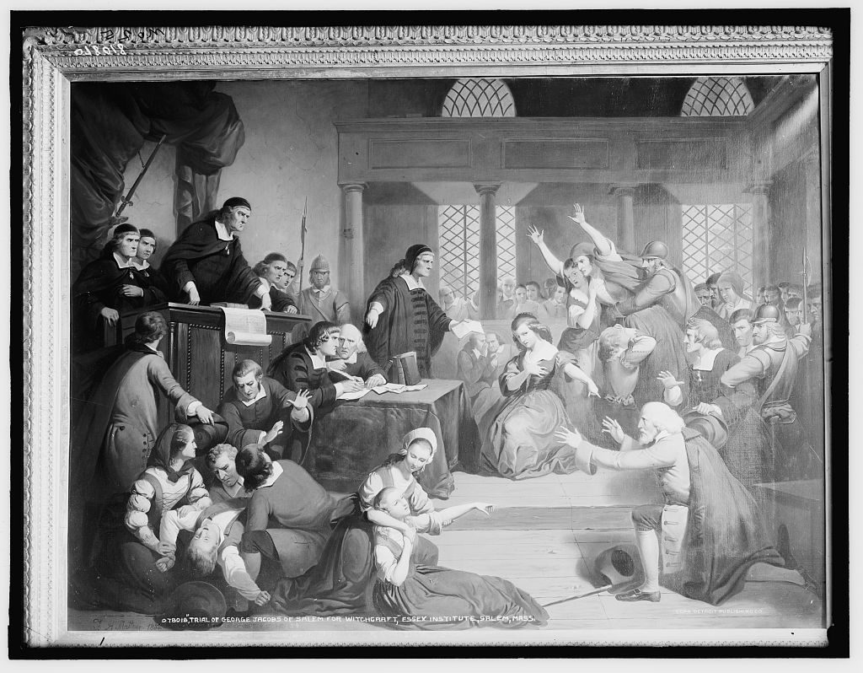
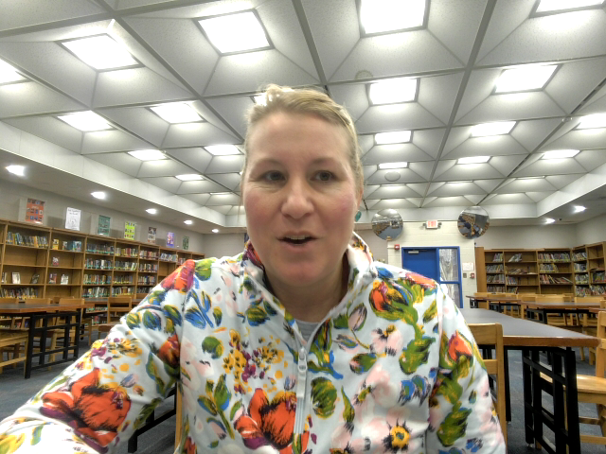
Moral Panic: Real 1962 Artifacts. Real Hysteria
Library of Congress Primary Sources and The Crucible
Trial of George Jacobs of Salem (photograph of a painting by Matteson Tompkins Harrison) Library of Congress Artifacts.

Slide 2
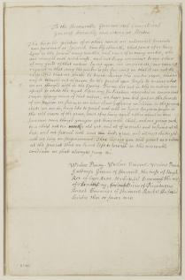
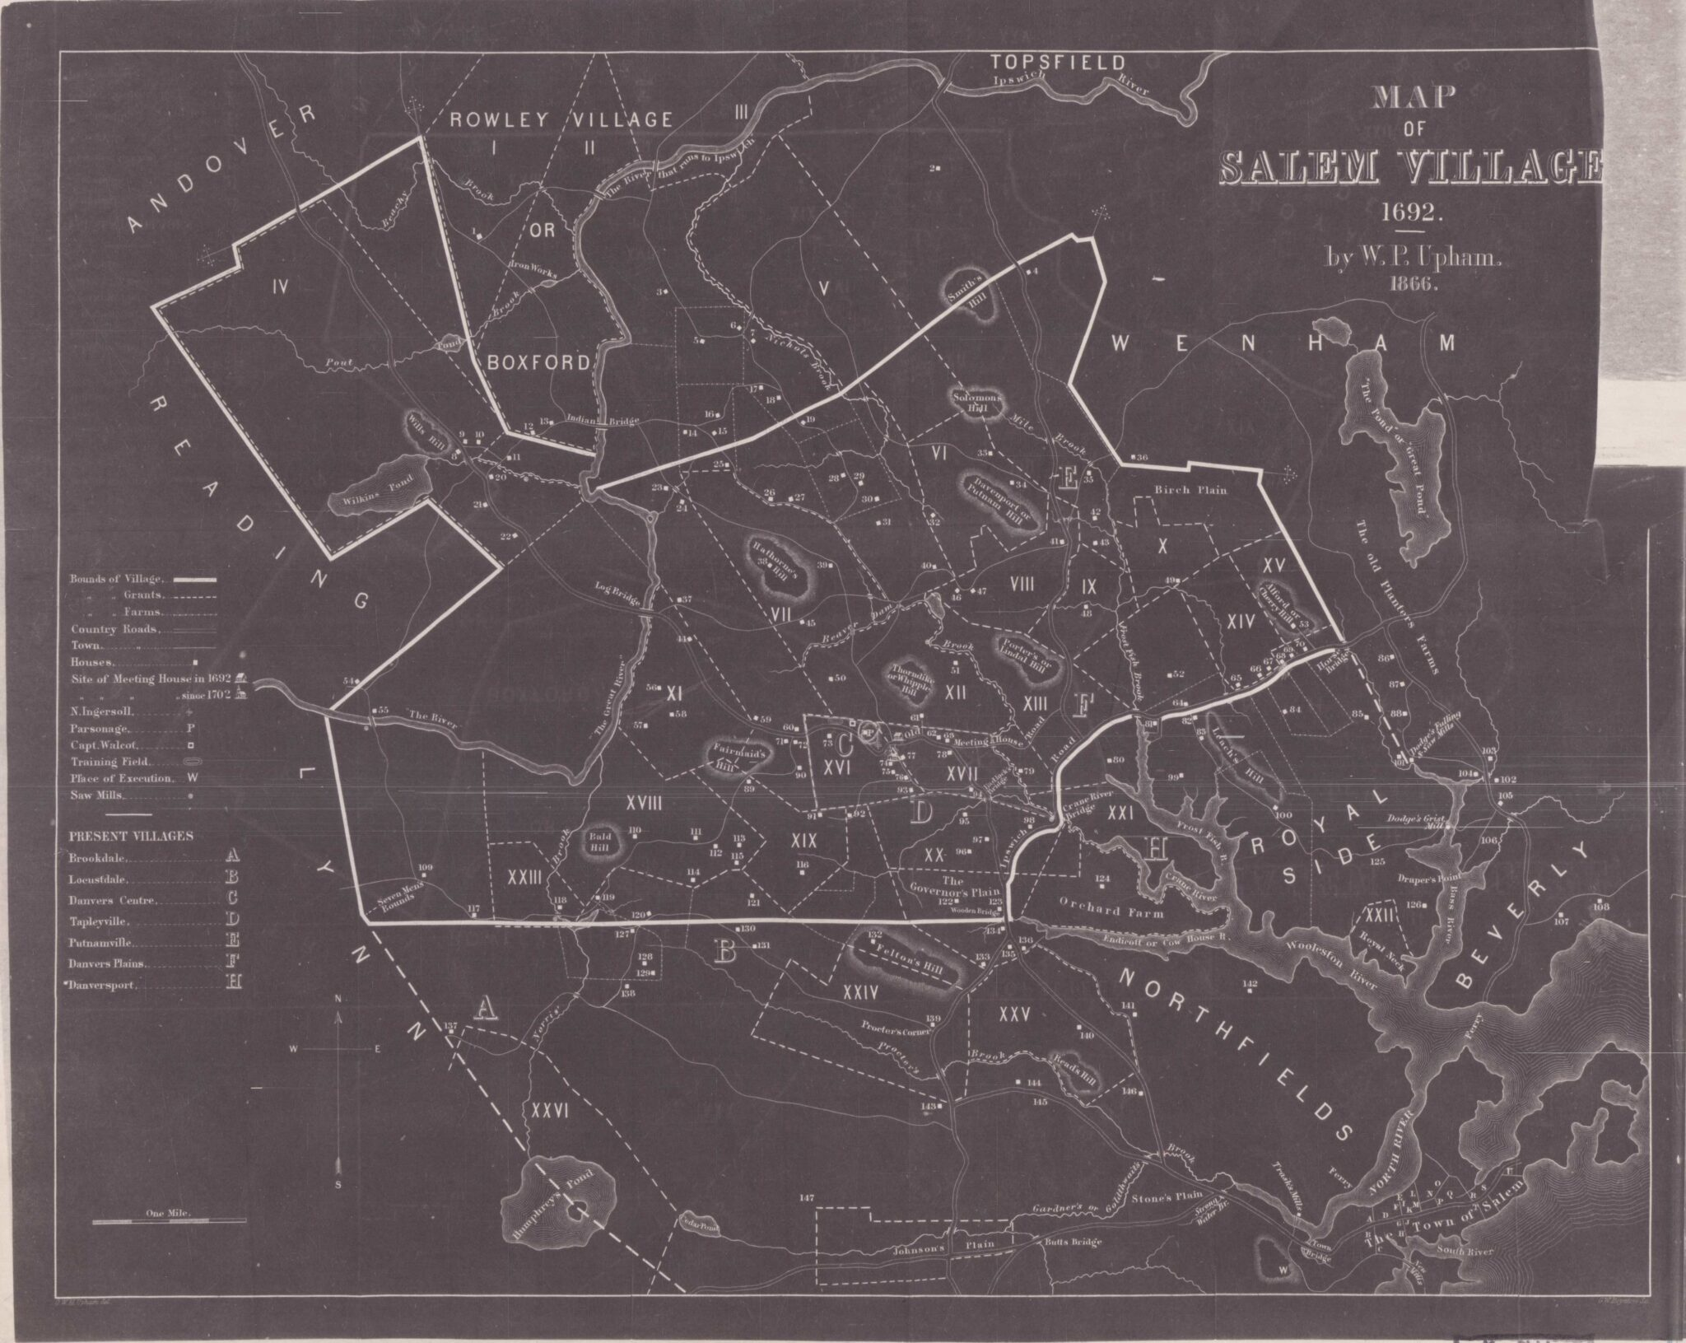
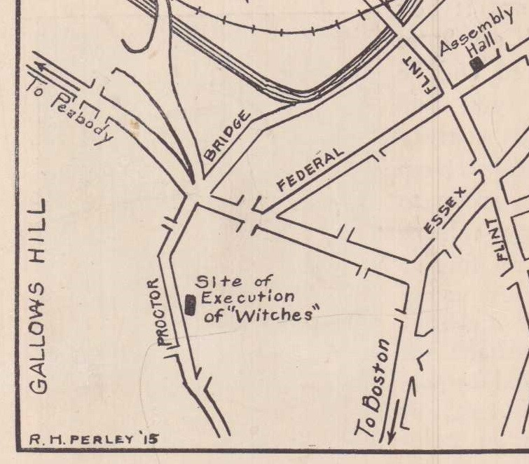
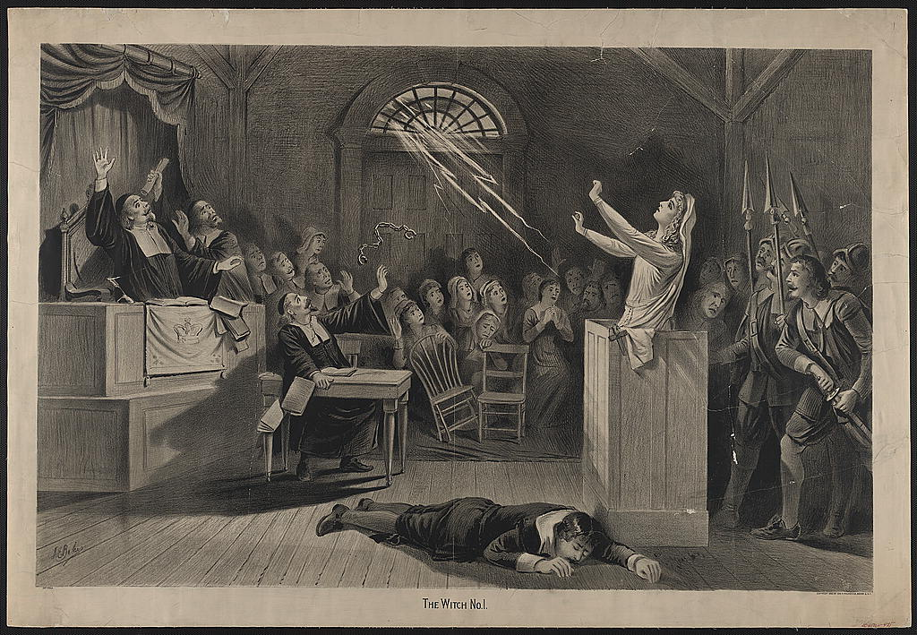
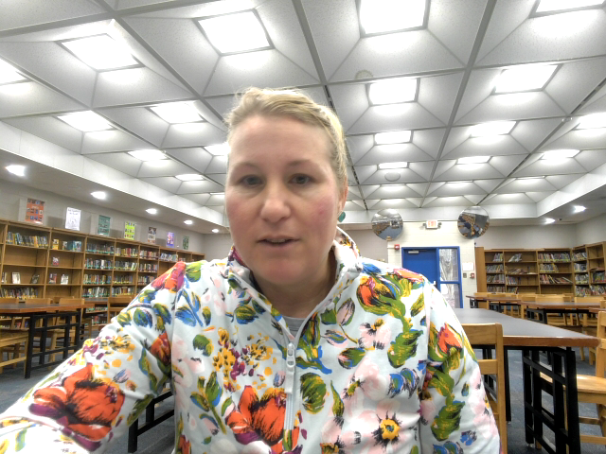
Petitions
Testimonies
Maps
Evidence

Slide 3
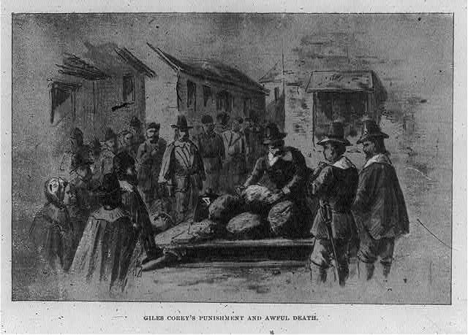
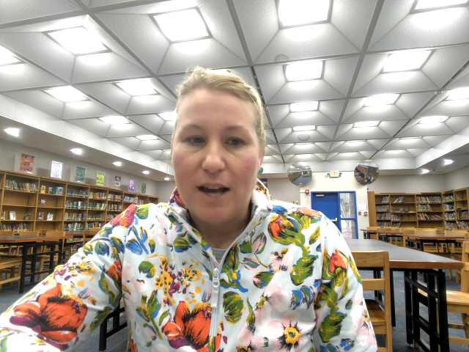

Slide 4

Assignment Ideas and Recap
Students create a podcast in the style of a true crime podcast.
A. Students can use Soundtrap to build professional quality podcasts
B. Students create and write scripts based on the Library of Congress (LOC) artifacts.
Students can use double-entry journals where either the students find and analyze important quotes or teachers can provide the quotes on the left side and students can analyze on the right side.
Students can also use the LOC images, to go on a QR Code Scavenger Hunt to provide, think Paul Harvey, The Rest of the Story… This can also be used to discuss what is omitted.
Students can be given a Role, Audience, Format, and Topic (RAFT) writing assignment where students assume the role of a lawyer and write an opening argument to the audience (jury) on the guilt or innocence of the specific character. For advanced students, I would have students submit evidence to the judge as to why “Spectral Evidence” should or shouldn't be admissible in court employing rhetoric. The could use actual “evidence” procured from LOC.

Slide 5
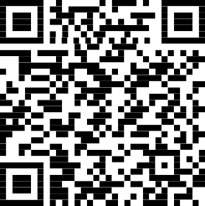
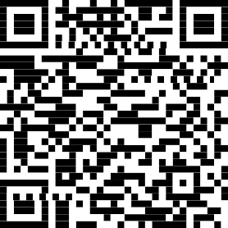

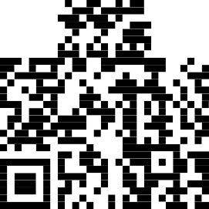

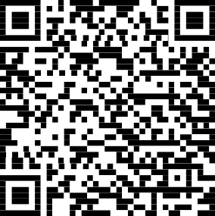
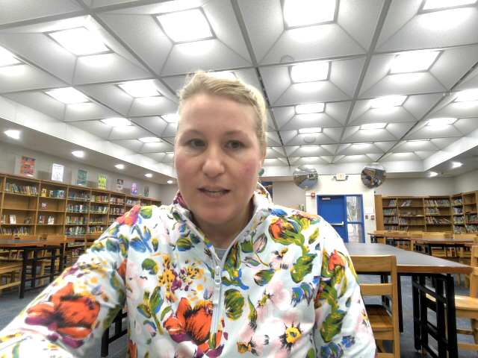
Petition for Bail – Accused Witches
QR Code Examples
Evidence from Invisible Worlds in Salem
Witch Hill (1870)
The Crushing Death of Giles Corey

Slide 6
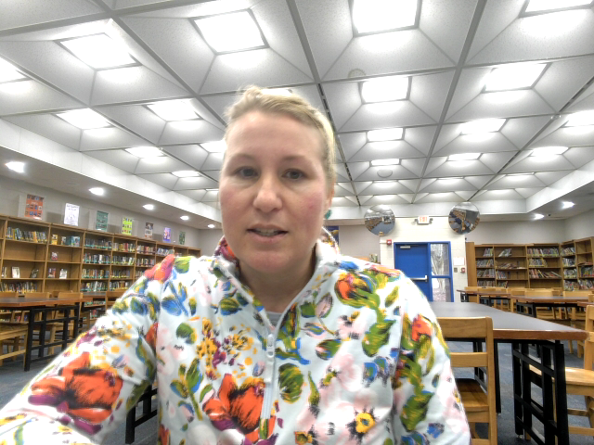
References
Deaver, L. (2022). Petition for bail from accused witches, ca. 1692 [Manuscript]. John Davis Batchelder Collection, Manuscript Division, Library of Congress. In Halloween greetings. Library of Congress Blogs. https://blogs.loc.gov/manuscripts/2022/10/halloween-greetings/
Kahn, S. (2022). Double double trials and trouble [Blog post]. Worlds Revealed, Geography & Map Division, Library of Congress. https://blogs.loc.gov/maps/2022/10/double-double-trials-and-trouble/
Library of Congress. (1871). The legend of Salem: “The Rev. George Burroughs was accused of witchcraft on the evidence of feats of strength, tried, hung, and buried beneath the gallows” [Photograph]. Prints & Photographs Division. https://www.loc.gov/item/98518206/
Library of Congress. (n.d.). The Witch House, Salem, Mass. [Photograph]. Prints & Photographs Division. https://www.loc.gov/pictures/item/98511037/
Matteson, T. H. (Artist). (n.d.). Trial of George Jacobs of Salem for witchcraft [Print]. Detroit Publishing Co., Library of Congress Prints & Photographs Division. https://www.loc.gov/item/2016817487/
Mudge, Z. A. (1870). Witch hill: A history of Salem witchcraft, including illustrative sketches of persons and places [Book]. Carlton & Lanahan. Library of Congress. https://www.loc.gov/item/11009228/
Pollock, F. (2020). The crushing death of Giles Corey of Salem, 1692 [Blog post]. In Custodia Legis: Law Library of Congress. https://blogs.loc.gov/law/2020/10/the-crushing-death-of-giles-corey-of-salem-1692/
Unknown author. (2020). Evidence from invisible worlds in Salem [Blog post]. In Custodia Legis: Law Library of Congress. https://blogs.loc.gov/law/2020/08/evidence-from-invisible-worlds-in-salem/

