Slide 1
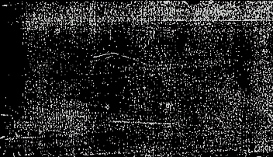


Rosemary for Remembrance
Assignment Ideas Using Library of Congress (LOC) Artifacts With The Teaching of Hamlet

Slide 2
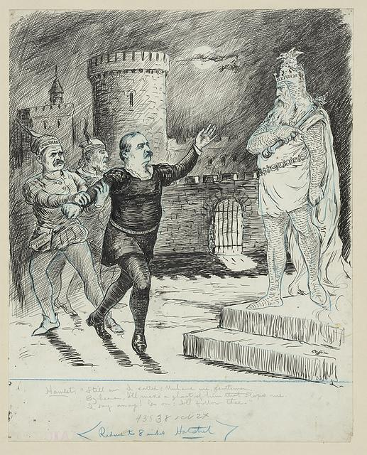


Library of Congress Political Cartoon Analysis using Hamlet Imagery.
After discussing how Hamlet can still be relevant today, I’d have students use Pixton to create their own comics or political cartoons.

Slide 3

Character Analysis Through Song
Taylor Swift has recently released a song titled Fate of Ophelia. Do you agree with her assessment of the character of Ophelia?
“The eldest daughter of a nobleman Ophelia lived in fantasy But love was a cold bed full of scorpions The venom stole her sanity”
Using evidence from the text of Hamlet, specifically Act 4 Scene 5, create a well crafted response to the question above using 1-2 paragraphs.

Slide 4

Casting Call
Lastly, there have been many ballets, theater productions, and movies inspired by Hamlet. Who would you cast today to play each character and why? You can create a video essay or organize the information in a written response.

Slide 5

References
Coffin, G. Y. (ca. 19th century). Still am I called, unhand me, gentlemen … Hamlet [Political cartoon].
Library of Congress, Prints & Photographs Division.
https://www.loc.gov/pictures/item/2016679780/
Bencke & Scott. (ca. 1873). Edwin Booth as Hamlet [Lithograph].
Library of Congress, Prints & Photographs Division.
https://www.loc.gov/pictures/item/96502191/
Gurney & Son. (ca. 1870). Edwin Booth as Hamlet [Photograph].
Library of Congress, Prints & Photographs Division.
https://www.loc.gov/pictures/item/2005678162/
Maclise, D. (artist). & Unknown engraver. (n.d.). The play scene—“Hamlet” from the picture in the Vernon Gallery [Engraving].
Library of Congress, Prints & Photographs Division.
https://www.loc.gov/pictures/item/98505914/
Brussel-Smith, B. (1957). Polonius’ charge to his son Laertes [Photomechanical print].
Library of Congress, Prints & Photographs Division.
https://www.loc.gov/pictures/item/2007675672/
Unknown photographer. (1955). Act III, Scene 2 of “Hamlet,” showing Claudius handing Laertes a knife, Mayakovsky Theater, Moscow, Russia [Photographic print].
Library of Congress, Prints & Photographs Division.
https://www.loc.gov/pictures/item/97514053/

